Slide 1
Design and Fabrication of Wind Turbine
Andy Ngo
Kevin Ye
Paul Teogalbo
Donnie Rambo
10/23/2012
San Jose State University Charles W. Davidson College of Engineering

Slide 2
Introduction
Project Purpose:
to design and fabricate a turbine rotor blade
to design and create the support structure
to determine the power output of the turbine
to determine the stiffness of the support structure
Goals:
to create an efficient, visually appealing turbine.
to create a solid, sturdy structure.

Slide 3
Introduction
Design constraints and variables for blade:
Blade length
Blade weight
Blade thickness
Blade shape
Blade number
Angle of attack
Design constraints and variables for structure:
Materials and structural integrity

Slide 4
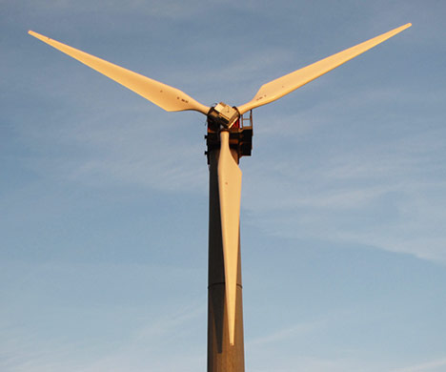
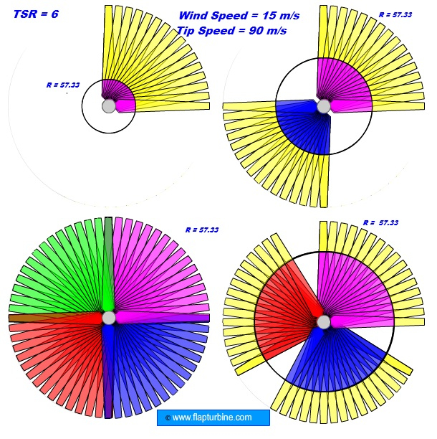
Design of Turbine Blade
We tried to emulate a design that was would provide high efficiency according to this model.
We found that a 3-bladed design would provide the most effective energy output due to area of wind sweep without increasing drag.

Slide 5
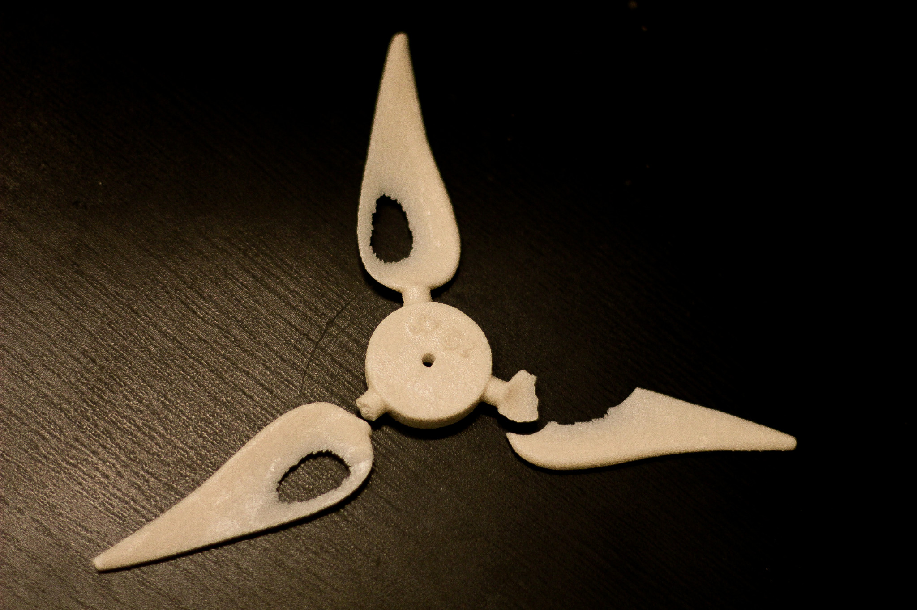
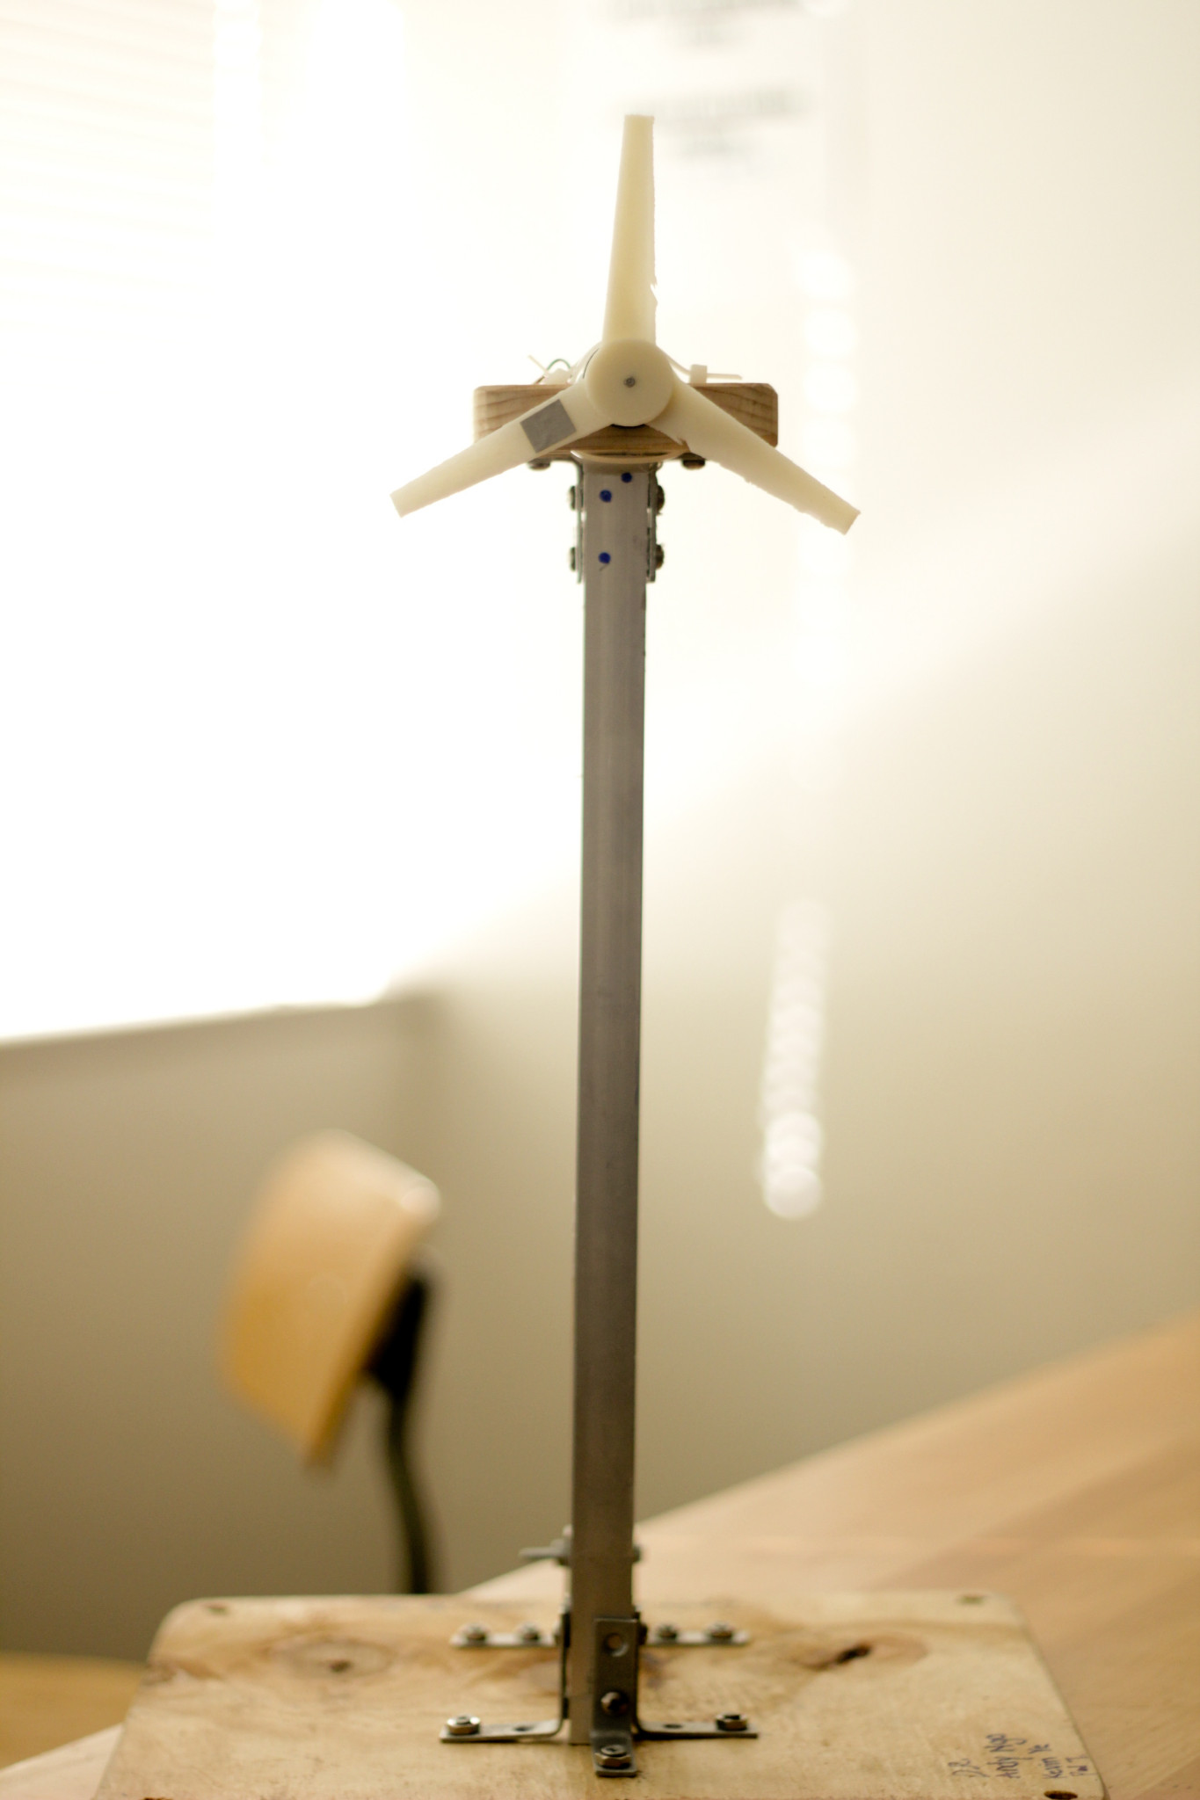
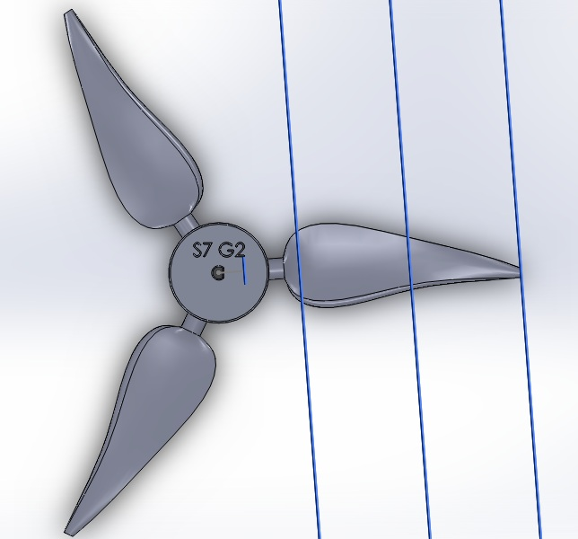
Replacement of Turbine Blade
R.I.P S7 G2

Slide 6
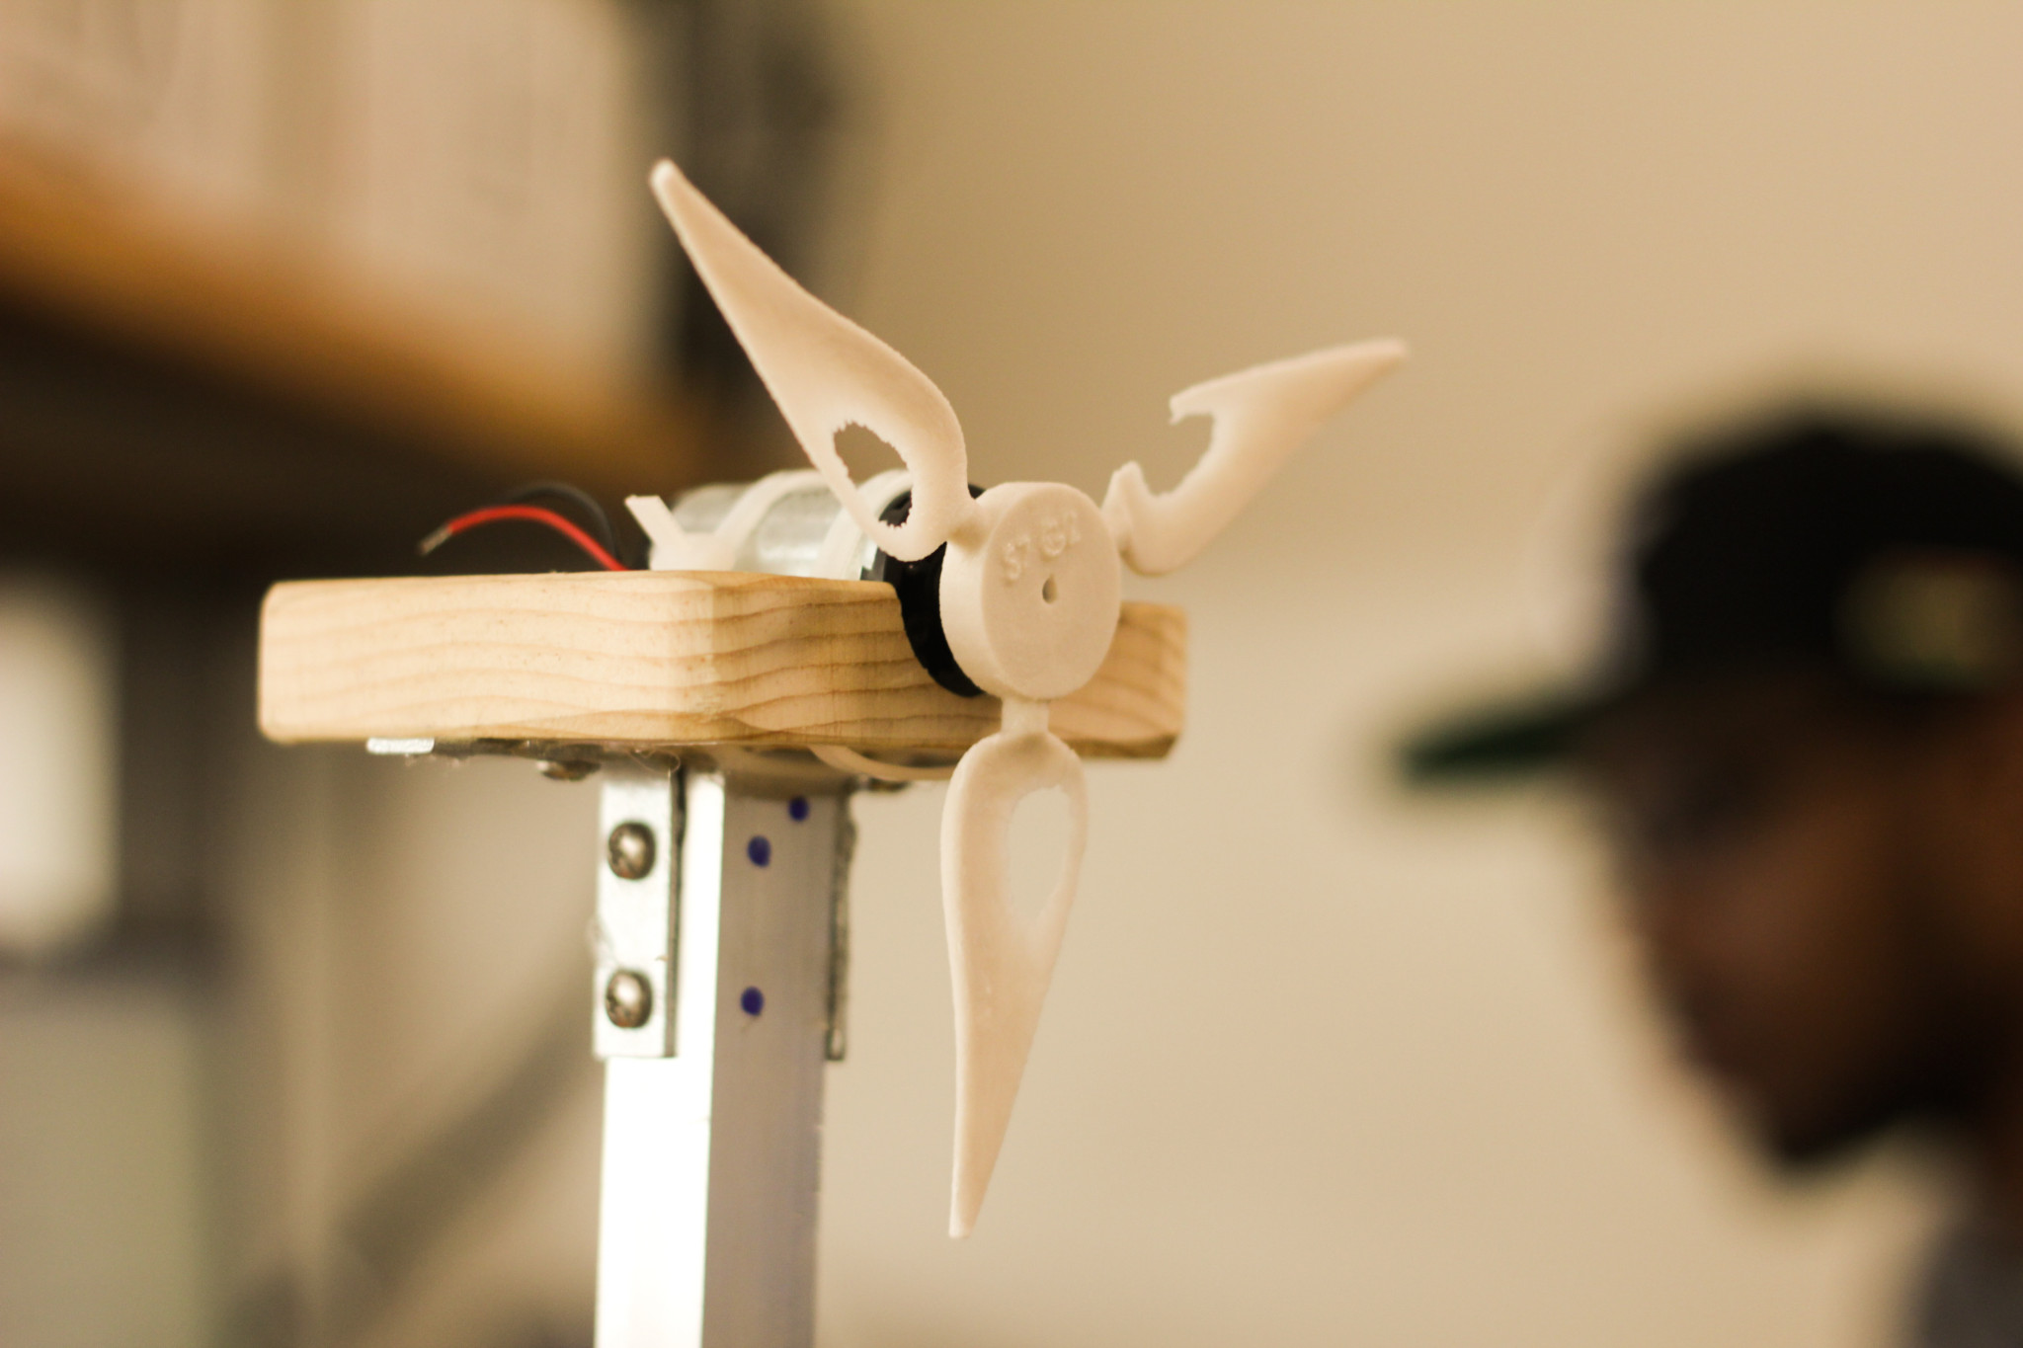
Design of Turbine Blade

Slide 7
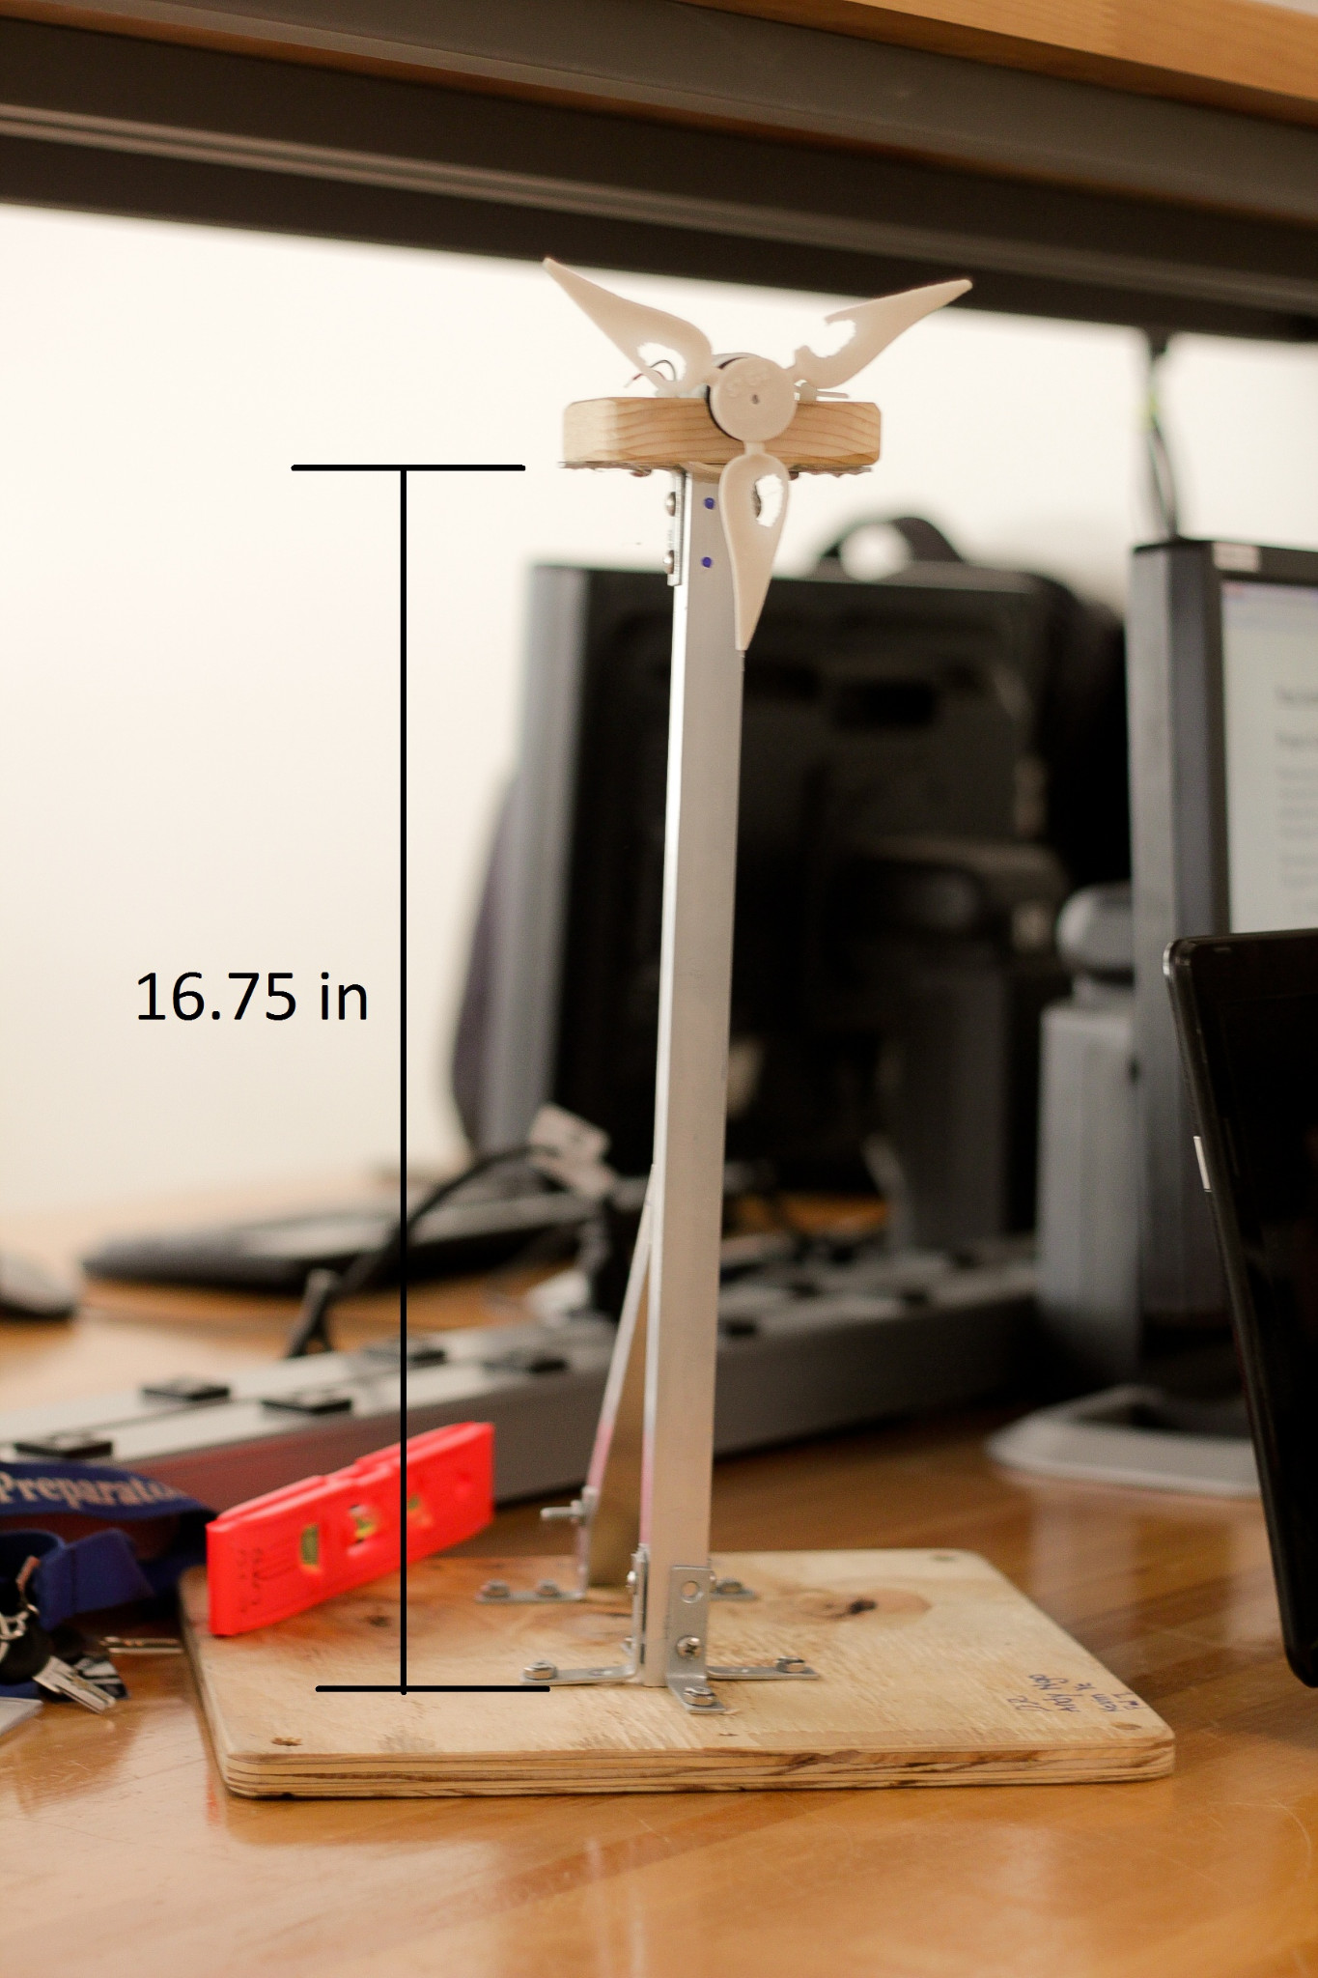
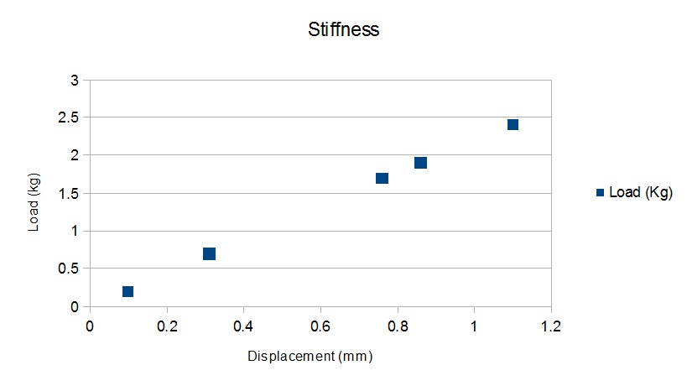
Structure Specifications
Material: Aluminum
Height: 16 3/4 inches
Weight:1205 g = 1.205kg

Slide 8
Testing the Turbine Blade
To properly test the efficiency of the turbine, our project underwent wind testing from an industrial-like fan at 29 mph top speed.
Included with the wind speed, we add 6 lightbulbs to test Voltage, Power, and Current from the turbine. The number of lightbulbs are increased over a course of time for proper analyzation.

Slide 9
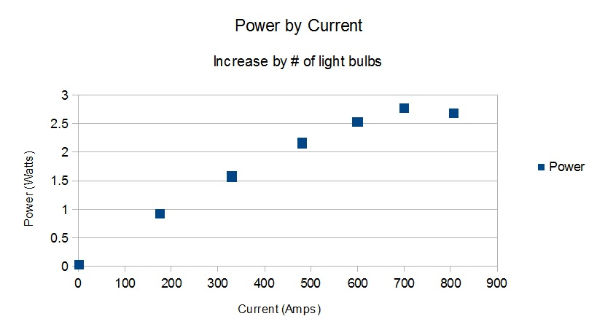
Performance of the Wind Turbine Statistics

Slide 10
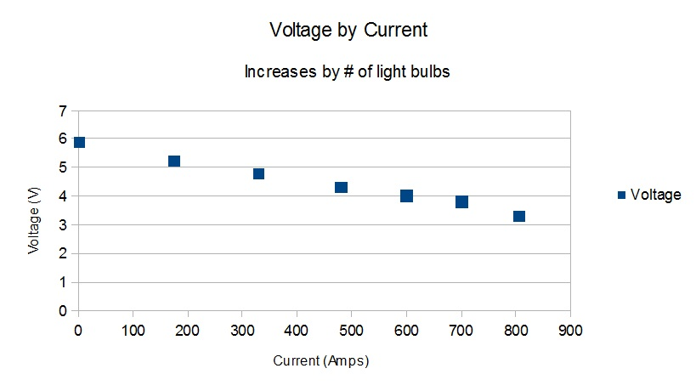
Performance of the Wind Turbine Statistics
Voltage over Current

Slide 11
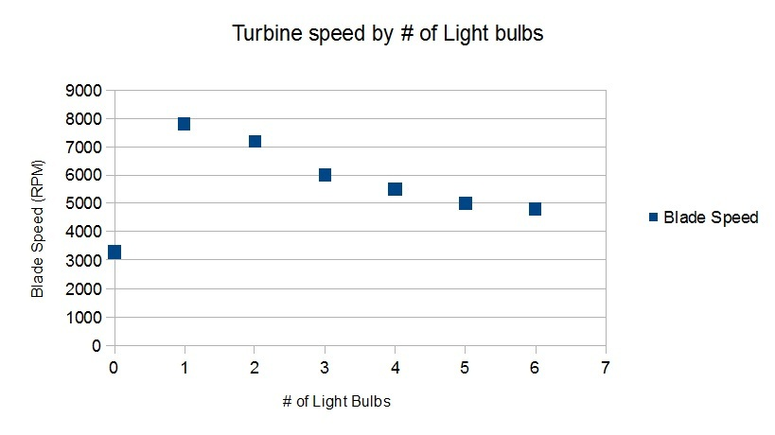
Performance of the Wind Turbine Statistics

Slide 12
Performance Results
Overall our 3-bladed design was well built to undertake the power of the high-speed fan during experimentation.
During testing we observe that as the number of light bulbs increase the Power increases as well. In vice versa Voltage is decreased, while both displayed the same level of Currents.
The Speed of the blade however, decreased as we increased the number of light bulbs present.

Slide 13
Conclusion
Project Summary
Everyone did their part on time
Materials and tools were easily available
Original Design blade broke
Non-contact Tachometer ran out of batteries
Disagreements on designs of the tower
Recommendations for future work:
Create a thicker, more durable blade
Designing Single Blade? Whale-fin type blade?
Structure integrity & design with Cables

